Slide 1
Famous Individuals with Different Abilities
January Lesson – Don’t Limit Me

Slide 2
Perseverance =

Slide 3
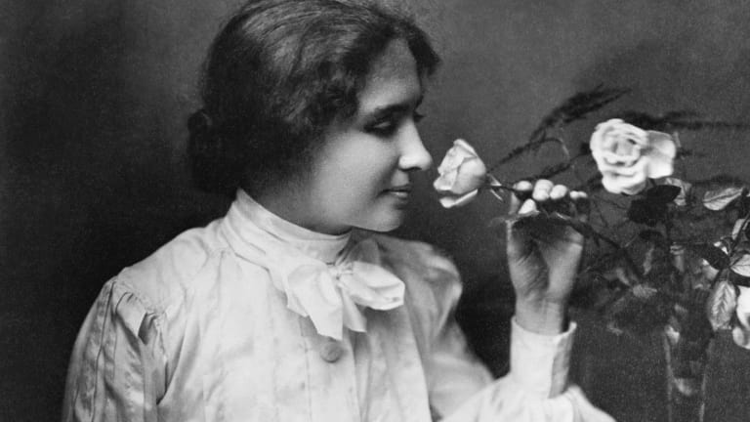
Helen Keller
Notes:
Images: https://www.google.com/url?sa=i&source=images&cd=&ved=2ahUKEwjBmqaQrcXkAhWHmeAKHX-ADcwQjRx6BAgBEAQ&url=https%3A%2F%2Fwww.nytimes.com%2F2009%2F03%2F08%2Fnyregion%2Fconnecticut%2F08spotct.html&psig=AOvVaw3yFKGVjJ6PZzrXVWOVgJYA&ust=1568173872425837 ; https://www.google.com/url?sa=i&source=images&cd=&ved=2ahUKEwi03bfArsXkAhVDheAKHaU8BYAQjRx6BAgBEAQ&url=https%3A%2F%2Fwww.history.com%2Ftopics%2Fwomens-rights%2Fhelen-keller&psig=AOvVaw3yFKGVjJ6PZzrXVWOVgJYA&ust=1568173872425837

Slide 4
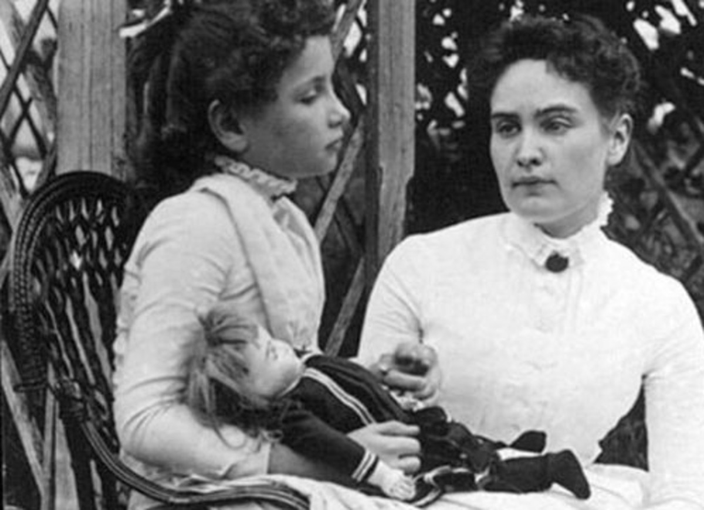
Born on June 27, 1880
Loss of sight and hearing
Had to learn new ways of communicating
Touch-lip reading, Braille, speech typing and finger spelling
Notes:
Image: https://www.google.com/url?sa=i&source=images&cd=&ved=2ahUKEwja0JmIsMXkAhVnkuAKHS3fBJAQjRx6BAgBEAQ&url=https%3A%2F%2Fwww.biography.com%2Fnews%2Fanne-sullivan-early-life-biography&psig=AOvVaw0z2AMHzGT88kdrgYlkSCwa&ust=1568174677059379

Slide 5
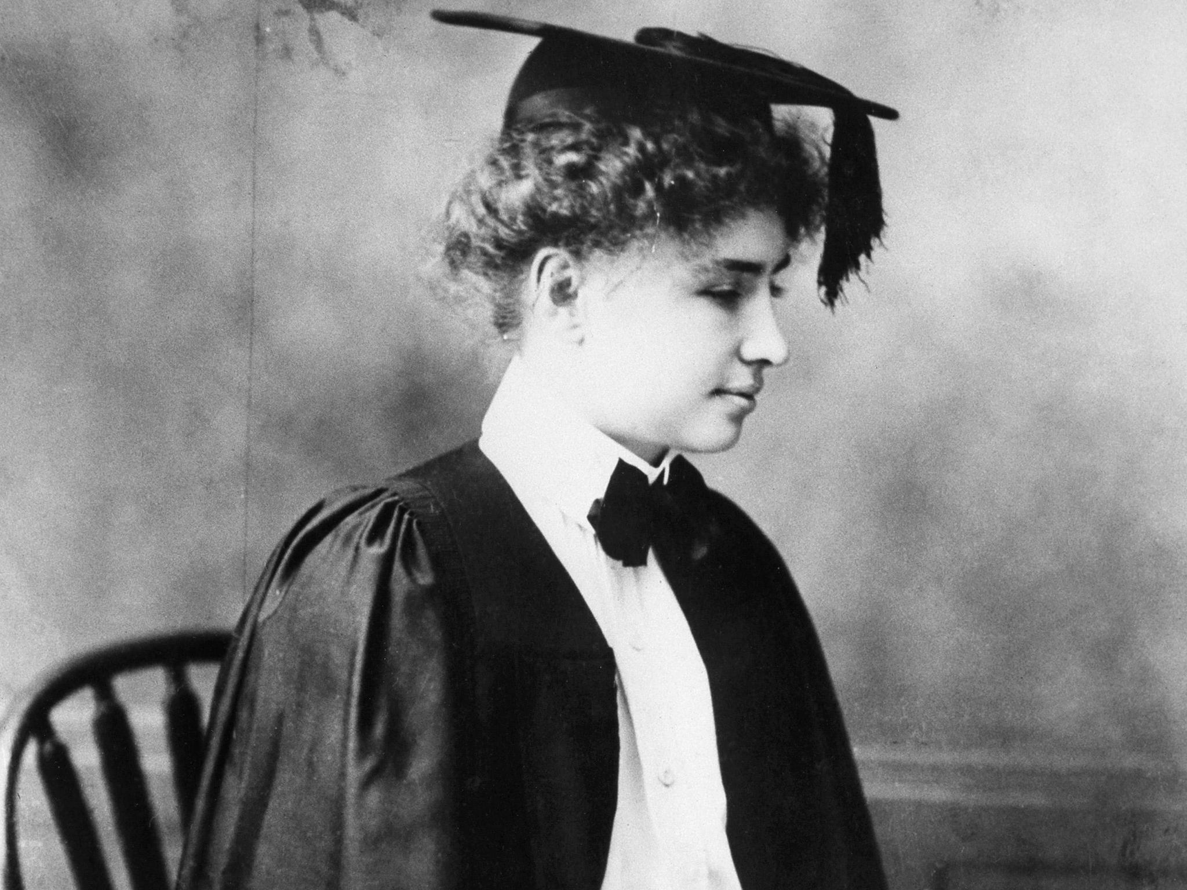
Received help from Annie Sullivan
Graduated from Radcliffe College with honors
Shared experience with others
Traveled across the world
Wrote books & won awards
Notes:
Image: https://www.google.com/url?sa=i&source=images&cd=&ved=2ahUKEwiRxufQrcXkAhWNmeAKHb_LB44QjRx6BAgBEAQ&url=https%3A%2F%2Fwww.independent.co.uk%2Flife-style%2Fwomen%2Fhelen-keller-day-2019-deaf-blind-de

Slide 6
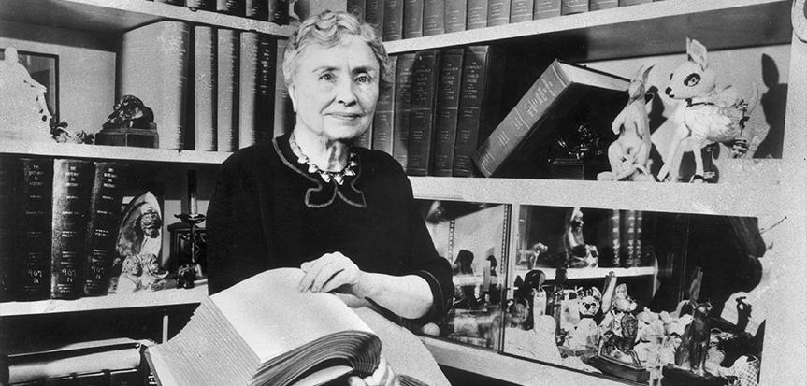
“We can do anything we want to if we stick to it long enough.”
- Helen Keller
“The most beautiful things in this world cannot be seen or even touched – they must be felt with the heart”
Notes:
Quotes: https://www.brainyquote.com/authors/helen-keller-quotes
https://www.google.com/url?sa=i&source=images&cd=&ved=2ahUKEwjyhJ6ZvcXkAhXHT98KHXHJDeQQjRx6BAgBEAQ&url=https%3A%2F%2Fwww.hki.org%2Fhelen-kellers-life-and-legacy&psig=AOvVaw3np6EC6h3WyD28AEsGOpD8&ust=1568178200372456

Slide 7
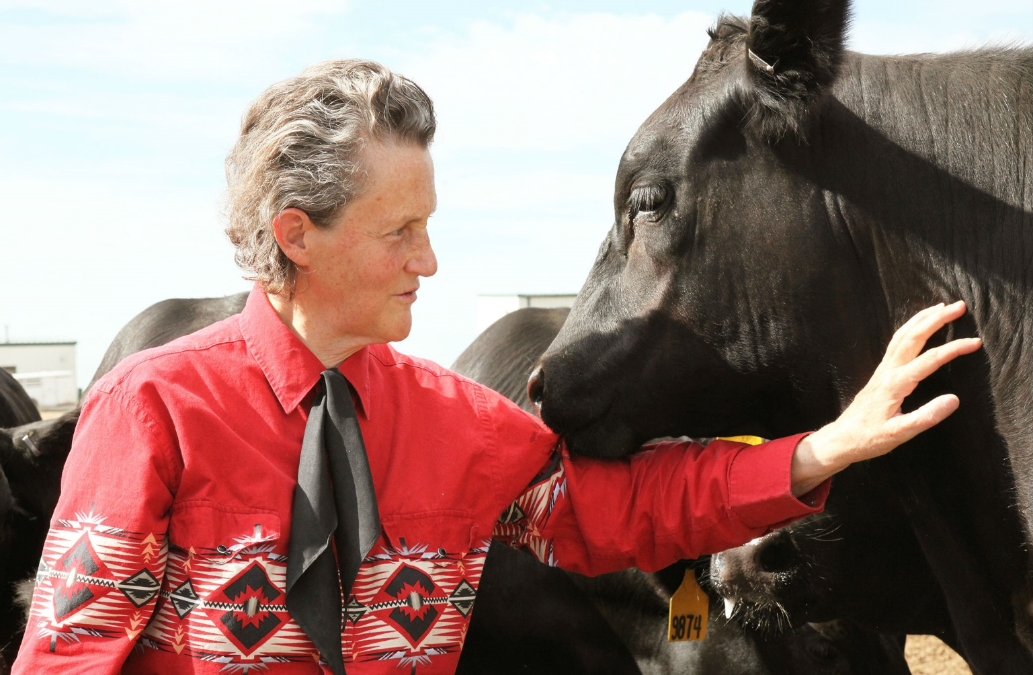
Temple Grandin
Notes:
Image: https://www.google.com/url?sa=i&source=images&cd=&ved=2ahUKEwiJp82btMXkAhWtmeAKHa1LBnsQjRx6BAgBEAQ&url=https%3A%2F%2Fwww.biography.com%2Factivist%2Ftemple-grandin&psig=AOvVaw3_raWDgWfbBTcb2uzDbaNw&ust=1568175783179889

Slide 8
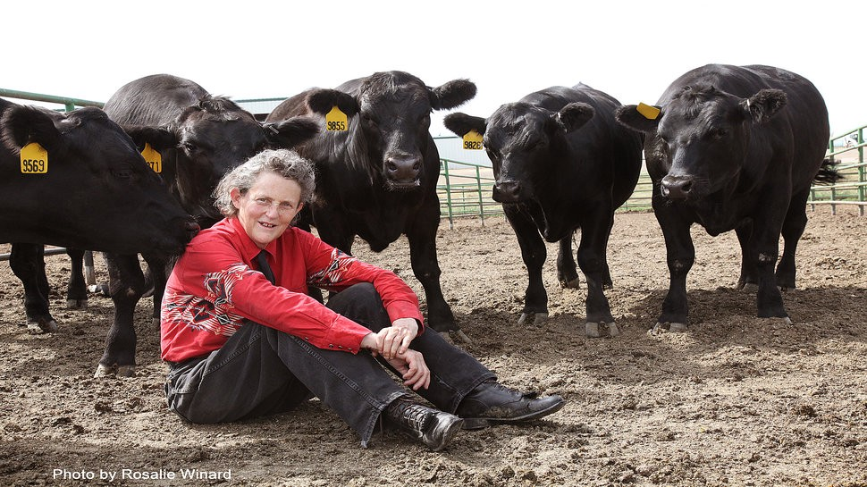
Born in Boston, Massachusetts 1947
Had trouble communicating and making friends
Sees the world in a unique way
Loves animals!
Helped improved farm animals quality of life
Notes:
Image: https://www.google.com/url?sa=i&source=images&cd=&ved=2ahUKEwjA5vHmtcXkAhWuTt8KHczFCKMQjRx6BAgBEAQ&url=https%3A%2F%2Famysmartgirls.com%2Ftemple-grandin-autism-is-an-ability-not-a-handicap-a1a42762593a&psig=AOvVaw3_raWDgWfbBTcb2uzDbaNw&ust=1568175783179889

Slide 9
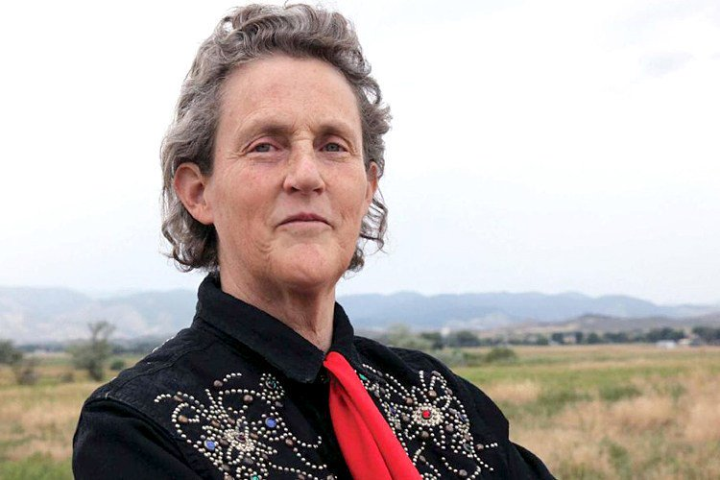
Very smart!
Earned three degrees
Wrote two books on animals
College Professor
Shares her story across the world!
Notes:
Image: https://www.google.com/url?sa=i&source=images&cd=&ved=2ahUKEwjkzOr5ucXkAhXuT98KHe7HABoQjRx6BAgBEAQ&url=https%3A%2F%2Ftwitter.com%2Fdrtemplegrandin&psig=AOvVaw3_raWDgWfbBTcb2uzDbaNw&ust=1568175783179889

Slide 10
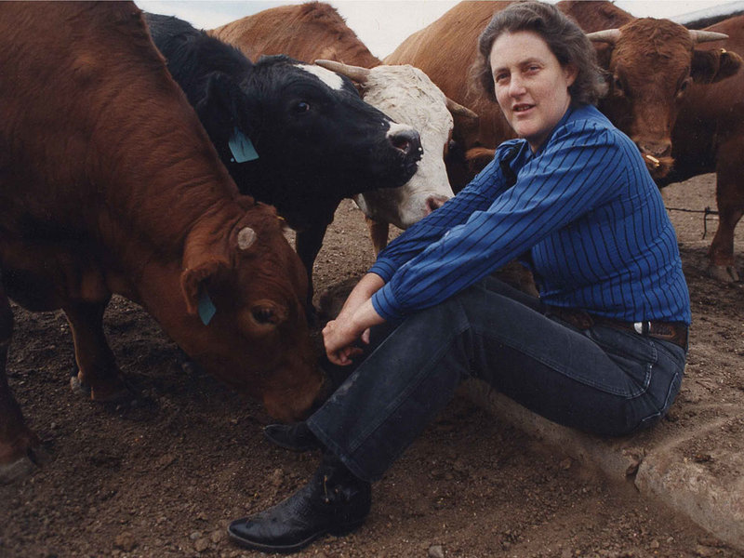
“The world needs all types of minds.” ― Temple Grandin
“My Advice is: You always have to keep persevering”.
Notes:
Quotes: https://www.goodreads.com/author/quotes/1567.Temple_Grandin?page=1
https://www.azquotes.com/quote/549337

Slide 11
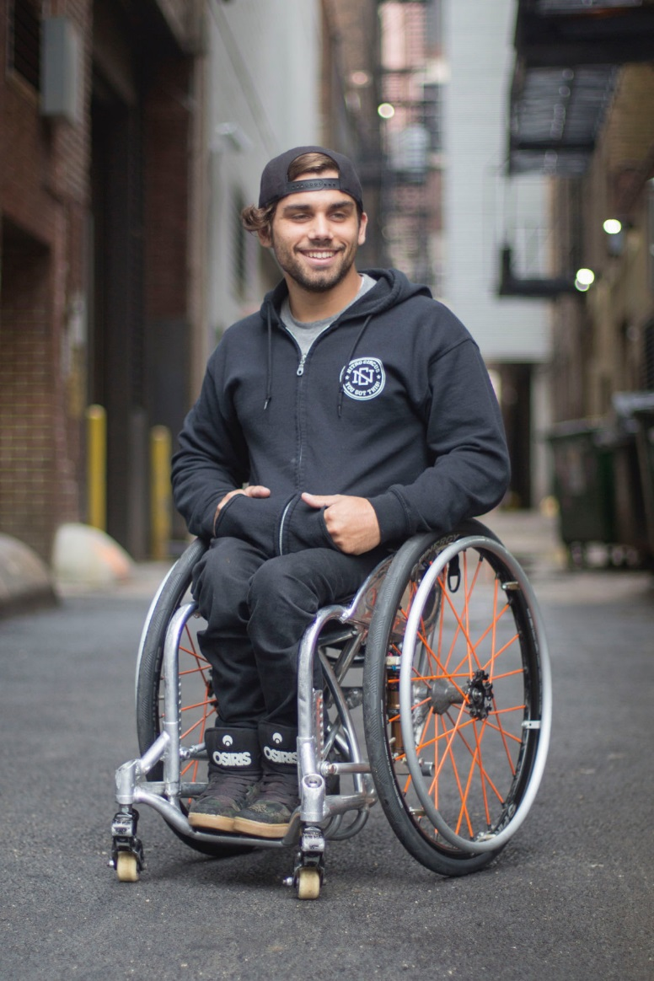
Aaron “Wheelz” Fotheringham
Notes:
Images: https://www.google.com/url?sa=i&source=images&cd=&ved=2ahUKEwj6k7XMvcXkAhUMTd8KHSFxCCsQjRx6BAgBEAQ&url=https%3A%2F%2Fwww.idahopress.com%2Foutdoors%2Fgnarly-boise-hosts-wheelchair-bmx-demo-and-clinic%2Farticle_4ef821e4-96f7-5677-a0d2-d4fdc1ccd247.html&psig=AOvVaw3v7vTsKuQEgQX56_zDRyXS&ust=1568178302456303

Slide 12
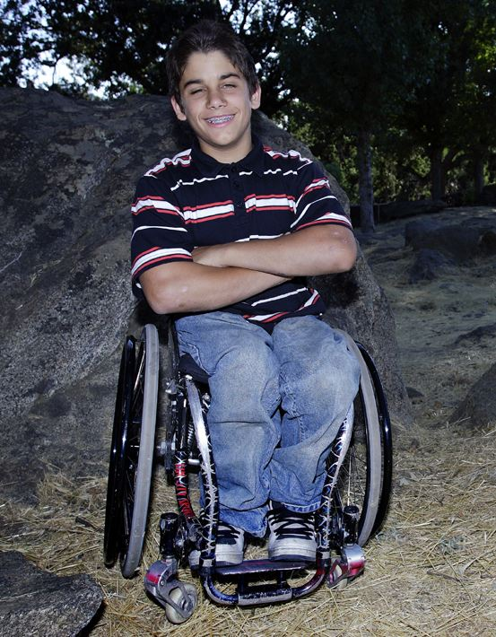
Born in Las Vegas, Nevada November 8, 1991
Has Spina Bifida
Introduced to BMX
Started riding a wheelchair at eight years old in skate parks
Notes:
Photo: https://www.google.com/url?sa=i&source=images&cd=&ved=2ahUKEwi0n5uuv8XkAhXqmeAKHX4ODS8QjRx6BAgBEAQ&url=https%3A%2F%2Fen.wikipedia.org%2Fwiki%2FAaron_Fotheringham&psig=AOvVaw2fGxWurL7sC4uNkexAmr4c&ust=1568178785981865

Slide 13
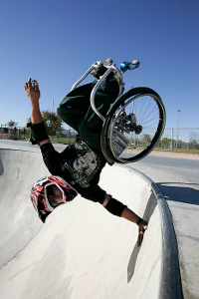
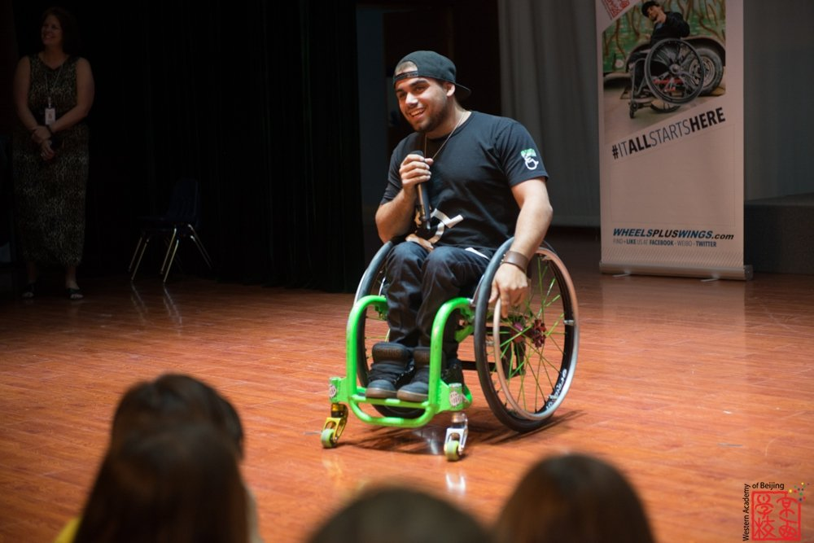
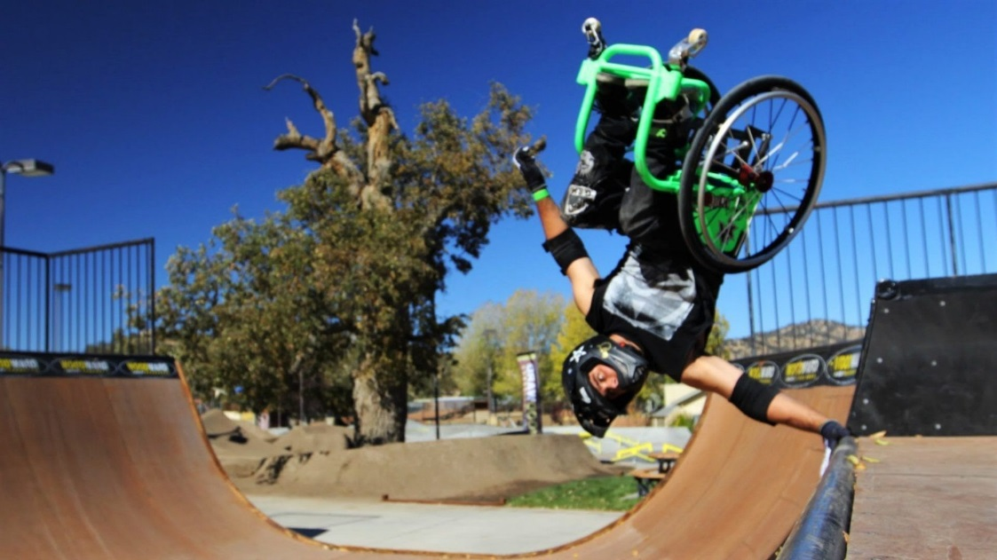
Practiced a lot!
Has won many competitions
Performed Wheelchair Backflip
Travels across the work – speaking and performing
Notes:
Photo: https://www.google.com/url?sa=i&source=images&cd=&ved=2ahUKEwjoifeewMXkAhUlWN8KHeEeBHIQjRx6BAgBEAQ&url=https%3A%2F%2Fwww.aaronfotheringham.com%2Fspeaking%2F&psig=AOvVaw2fGxWurL7sC4uNkexAmr4c&ust=1568178785981865
https://www.myhandicap.com/fileadmin/_migrated/pics/200x300_aaron-fotheringham-bland-01_02.jpg

